Slide 1
SupplyASAP
Deliver critical resources when you need it the most

Slide 2
Problem
“I urgently need supplies to maintain my operations during pandemic.
How might I mobilize the supplies in an efficient way?”
Judy Taylor
Procurement Manager of Hospital in NYC

Slide 3
Imbalance resources due to over ordering and hoarding
Florida
New York
Not to scale
1.8m
18 x
Florida has requested double the amount of masks per infected patient vs NYC
Florida is further back in the COVID curve and it is hoarding necessary equipment needed by NYC
38 x
430k
100k
11k
Mask requested by state
Covid Cases in state
Mask requested by state
Covid Cases in state
Source: Vox, NY Post, Microsoft Bing

Slide 4
Vision
“To reimagine the medical supply chain by creating a new exchange.”

Slide 5
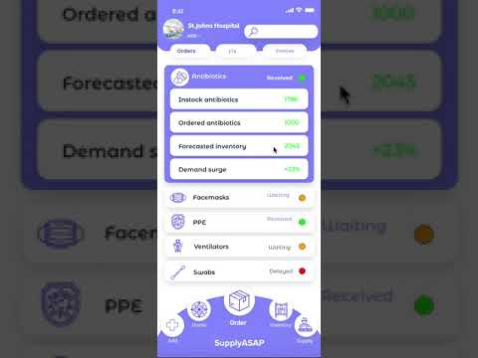




Our Solution
A predictive P2P procurement platform for the medical industry to unlock surplus and solve shortage
Inventory Forecasting
P2P Marketplace
Powered by
AI Predictive Model
Process
Mining
Click here for static demo

Slide 6




Technical Execution
Hospitals
Storage
ML
Forecast
Process Mining
API
Transactions
SupplyASAP
CoLab ML work - https://colab.research.google.com/drive/12XRYxVoej--bRKixiz6JGPgyksu8y3va

Slide 7

Uniquely positioned to tackle the current market inefficiencies
 | SupplyASAP | Sowingo | MyMediSet
Designed for Healthcare | +Crisis Mgmt.
P2P Exchange |  | Ecommerce
AI for inventory forecasting | Advanced | Low | Mid
API Integration

Slide 8
Our product has the potential to positively impact the current COVID-19 situation
800k
Up to
50%
Up to 75%
Front line medical practitioners in the US in need of protection¹
Of inventory can be Unlock and redeployment to those in need²
Reduction in delivery time, from 12 days to 3 days³
1. Statista; 2. Based on Florida vs NYC analysis, 3. Assuming no production timeline as finished goods in surplus are traded instead of being produced

Slide 9




How Do We Make Money
Current Revenue Model:
Transaction Fee
1.5% of transaction
Invoice financing fee
1.25% of invoice value for 30 days
Future Revenue Streams:
Onboard Suppliers / Manufacturers (B2B Marketplace)
White Label essential equipment

Slide 10
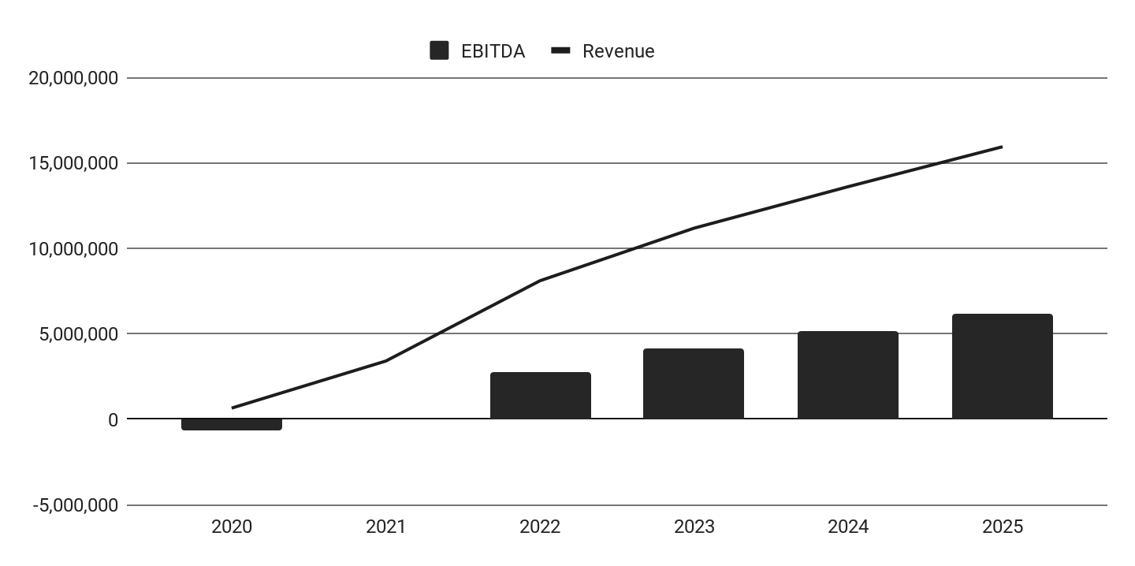


Viable business model, with ability to breakeven in
24 months
GTM Strategy
Financial Forecast
USD
66% discount for 12 months of operation
Keep refining value proposition to hospitals post-COVID
Remarks: Forecast does not include B2B marketplace and white label potential

Slide 11




4 Weeks to Launch; 8 Weeks to Scale
Validate and Scope
Develop
Pilot
Scale
1 week
3 weeks
4 weeks
4 weeks
Scope MVP
Further experiment predictive model & process mining
Build UI and mobile application
Finalize MVP
Arrange partner logistics platform
Onboard 50 pilot hospitals and collect data set (for free)
Launch beta application for feedback
Pilot P2P exchange
Gather user feedback
Expand user base to 200
Scale to expanded user base to 1,000 hospital cross-states
Pilot predictive model
Enhance predictive algorithm and process mining

Slide 12







Team of passionate drivers with the full-suite skills
Supriya Rai
Serial Tech-Entrepreneur
Atharv Mudur
Technology Strategist
Andrzej Manujło
Data Science Researcher
Aleksandr Kasian
Computer Science Expert
Carlos Jo Loo
Venture Capitalist
Sandra Lam
Corporate Innovator
Prasshanna S
UI/UX Designer
We have all it takes to start NOW

Slide 13
APPENDIX

Slide 14
Hospital severely impacted by the breakdown of the industry supply chain
64%
15x
Normal prices
9%
of COVID cases
of survey
respondents admitted to hoarding supplies¹
Surge in demand, has lead NYC to pay above market prices²
In Italy, 9% of COVID cases are healthcare workers, need to protect our front line³
1. Healthcare finance News, 2. Vox, 3.

Slide 15



Our value proposition to hospitals
Better inventory planning, by leveraging AI models for prediction
Reduce costs of inventory by better managing demand & supply
Enables most impacted hospitals to get access to critical equipment fast

Slide 16












List of resources to distribute via our P2P marketplace
Phase I: Focus on consumables PPE ( Weeks 1-2)
Phase II: Focus on capital equipment (week 3 - 4)
Surgical masks
Isolation gown
Mask N95
Latex Gloves
Boot cover
OT Cap
Face shield
Plastic Apron
Hand Sanitizers
Goggles
Stethoscope
Physiological Monitor
Ventilator
Mobile air purifier

Slide 17







Platform Roadmap
Phase II: Long term vision
Inventory forecast platform with P2P & B2B marketplace; Domestic and Cross-border
Hospitals
Bank (invoice financing)
Phase I: During COVID 19
Inventory Forecast with P2P marketplace
Logistics Partner
Clinic
SupplyASAP
Logistics Partner
Inventory Mgmt platforms
Medical Supplies company
Charities

Slide 18
We enables two transaction types
Direct sale of goods between P2P
Product credits between P2P
Equipment (t+3)
Equipment (t+3)
Hospital A
Hospital B
Hospital A
Hospital B
Data
SupplyASAP
Data
Data
SupplyASAP
Data
Model determines best market price & recommends quantity to purchase
System keeps tracks of items delivered and received for clearance
Payment
(t+1)
Supplier
Delivery
(t+12)
PO
(t+1)

Slide 19




Investment proposition
$25,000 Overheads
We are seeking $600,000 funding for our next 6 months
The funding will allow us to deploy our product, support hospitals and test product market fit
$75,000 COGS
$250,000 Other Salaries
$250,000 Engineering Team

Slide 20
Key Risks & Mitigations
Risks
Mitigations
Integration of SupplyASAP with existing inventory management systems
Create an additional interface with simple UI/UX for direct input
Country restricts non-essential travel, impacting the logistics flow
SupplyASAP enables the flow of essential medical equipment which will be exempt
Compliance with regulators PPE may remain stringent, limiting SKUs of PPE
Potentially use database of inventory to convince the regulator of excess stock

Slide 21
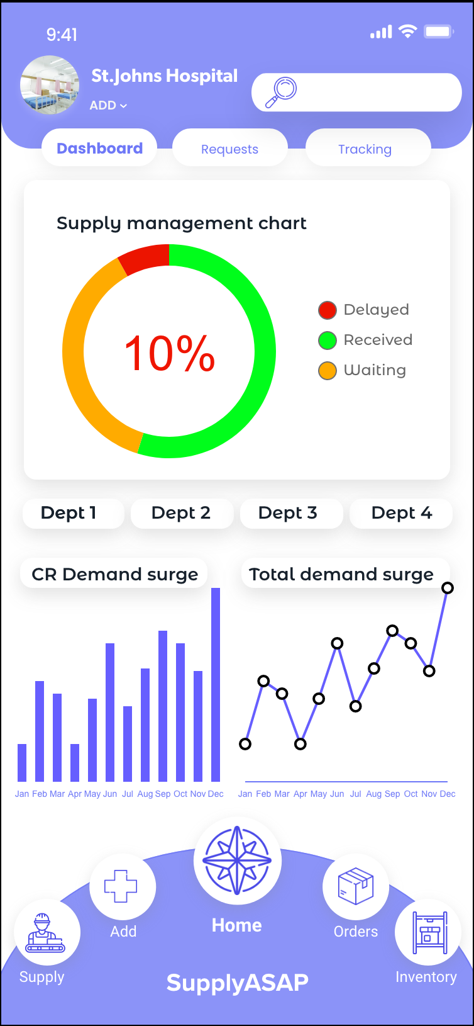
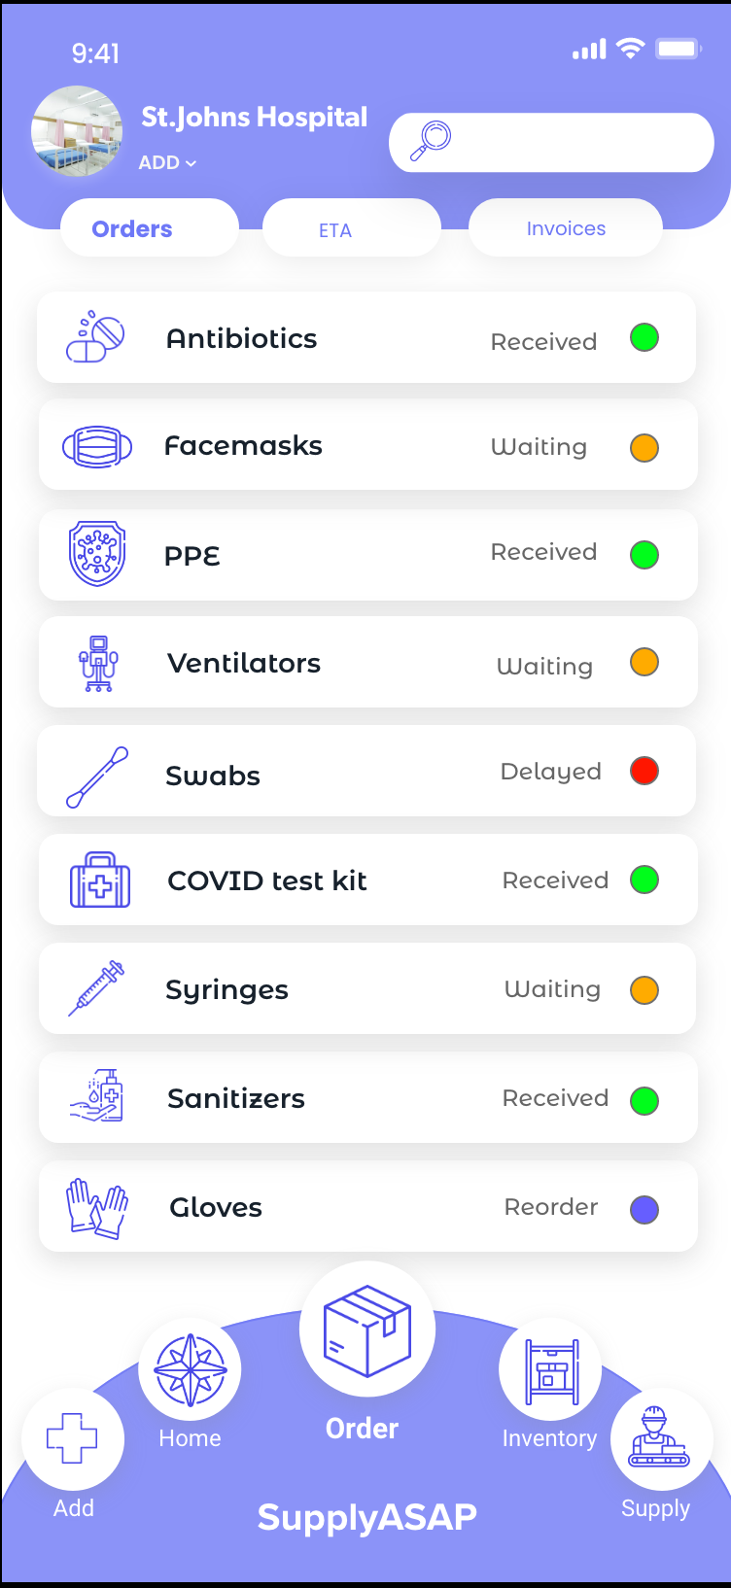
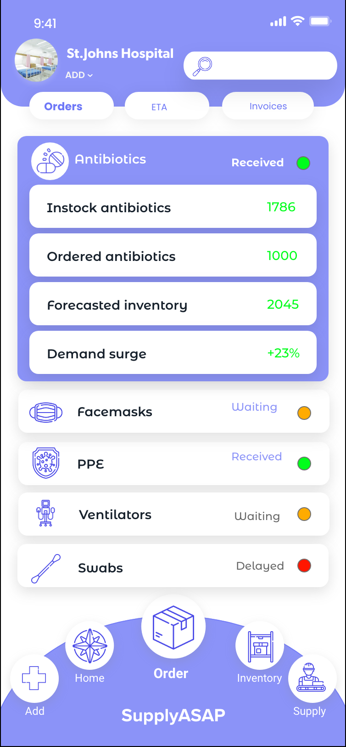
Product demo - Key Features (1)

Slide 22
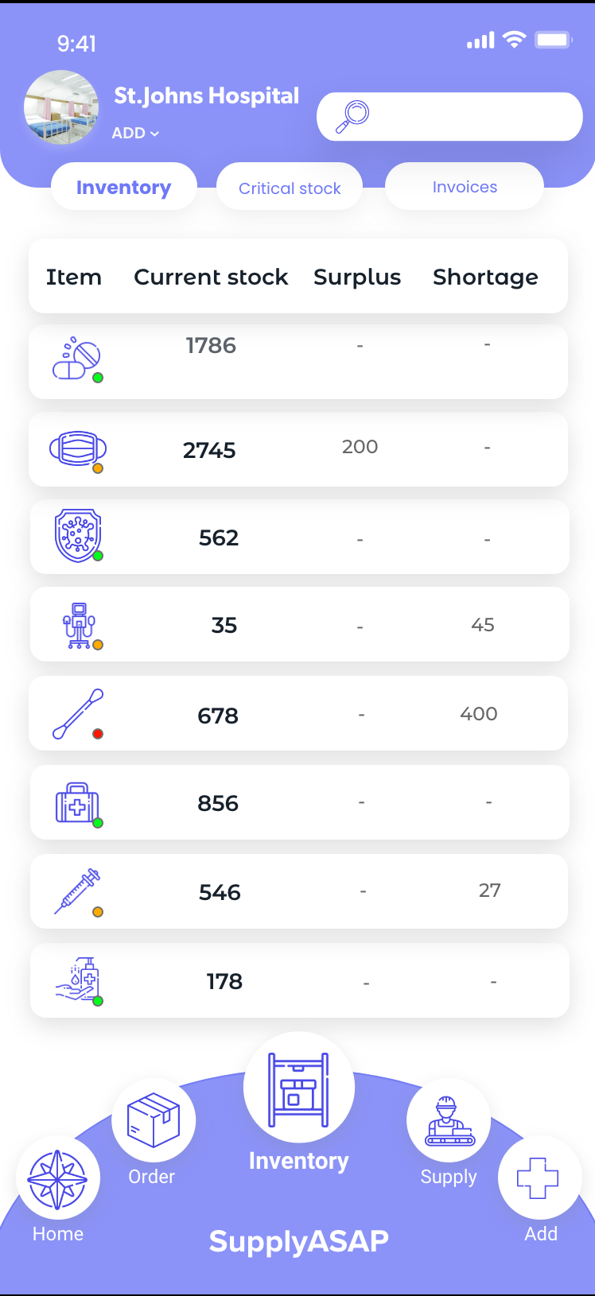
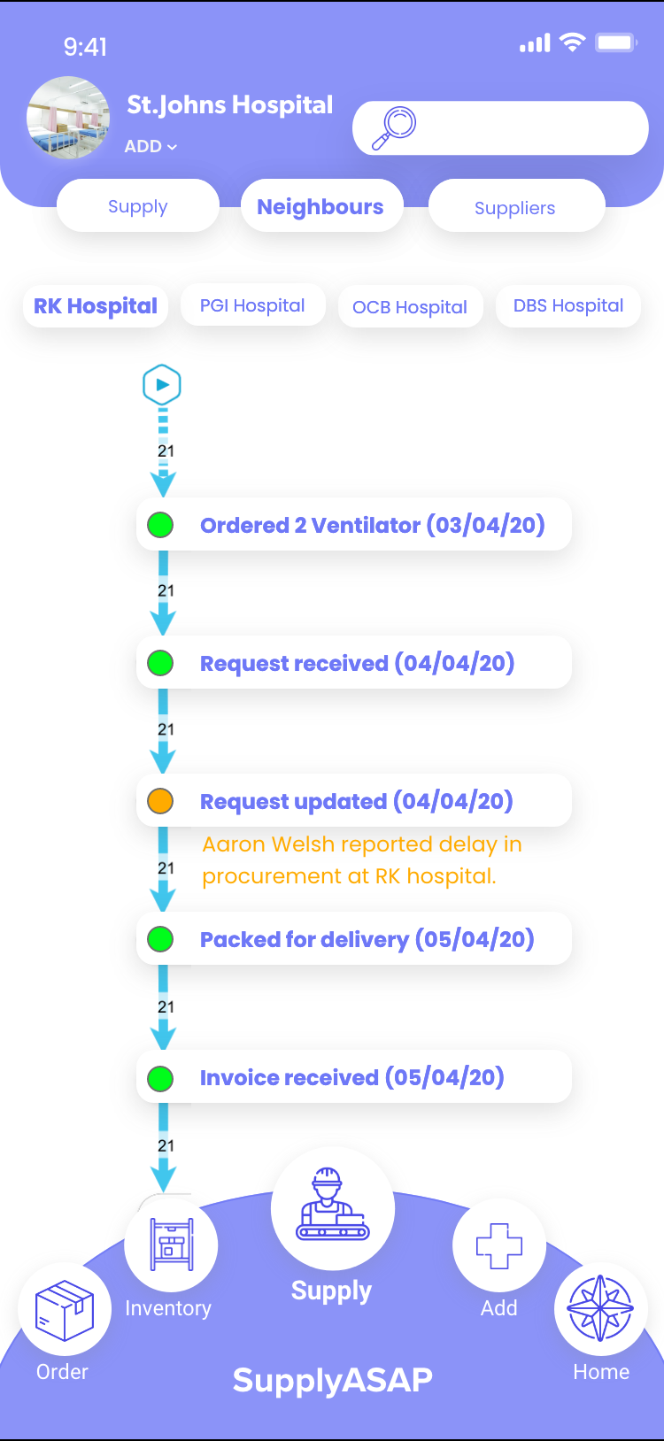
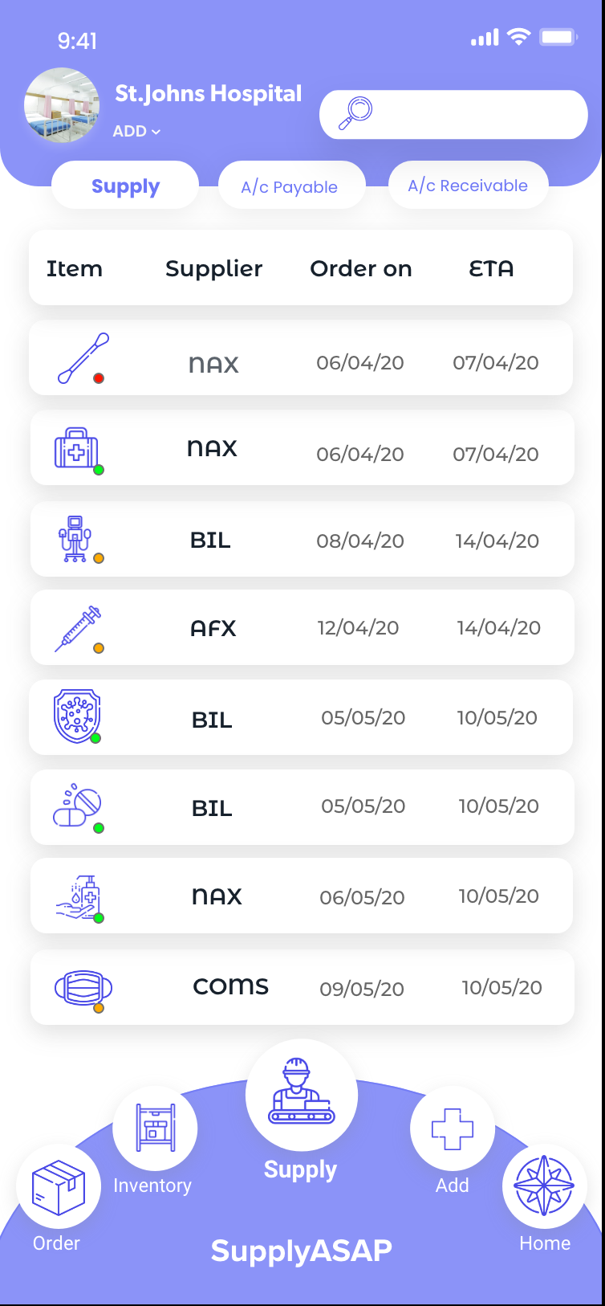
Product demo - Key Features (2)
Click here to go back to slide flow

